Slide 1
Frontend course session 1 Introduction to Programming World
Created by Ahmed Samir

Slide 2

Agenda
Ice breaking & introduction
How a website works
Backend & API & Frontend Roles
Course Overview
Course installation
HTML
Tasks
Resources

Slide 3
Icebreaker Activity
Objective: Get to know your classmates!
Instructions: Each participant shares:
Name
Academic Year & College
Programming Languages Known
Current Work in Tech? (Y/N)
Future Career Goal

Slide 4
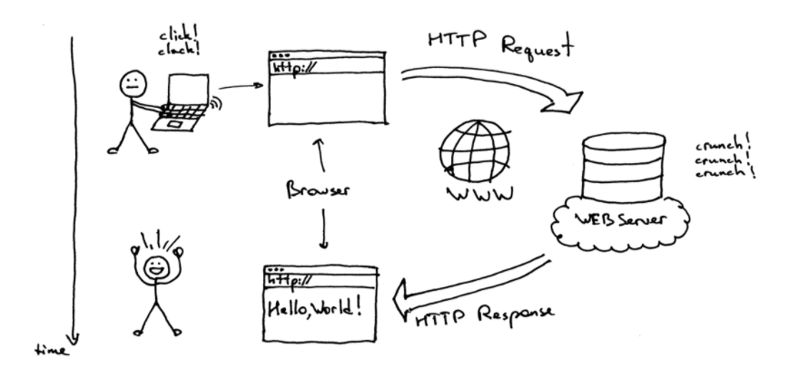
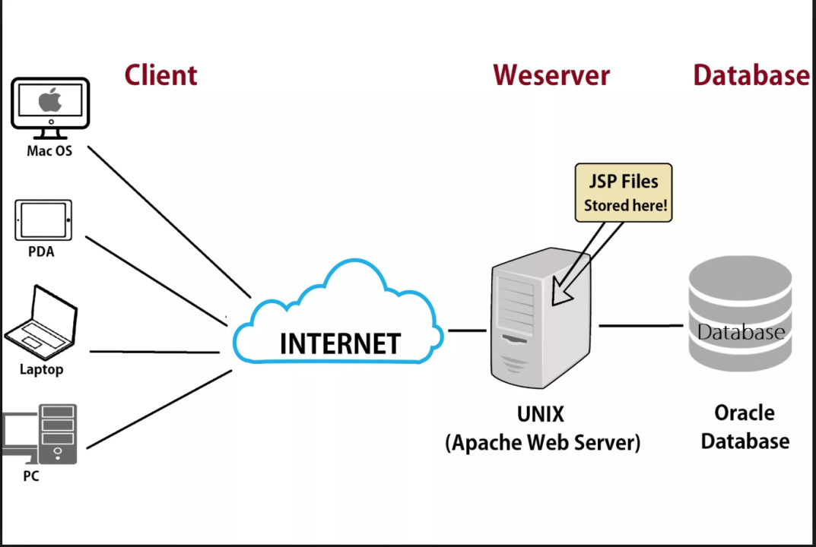
How Websites Work
Web Server
Databases
Backend
API
Frontend

Slide 5
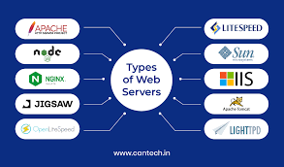
How Websites Work
1- web server: A web server is a computer hosting one or more websites. "Hosting" means that all the web pages and their associated files are available on that computer. The web server will send web page files it is hosting to a user's browser when they attempt to load it. Don't confuse websites and web servers.Jun 23, 2025 What is a web server? - Learn web development | MDN

Slide 6
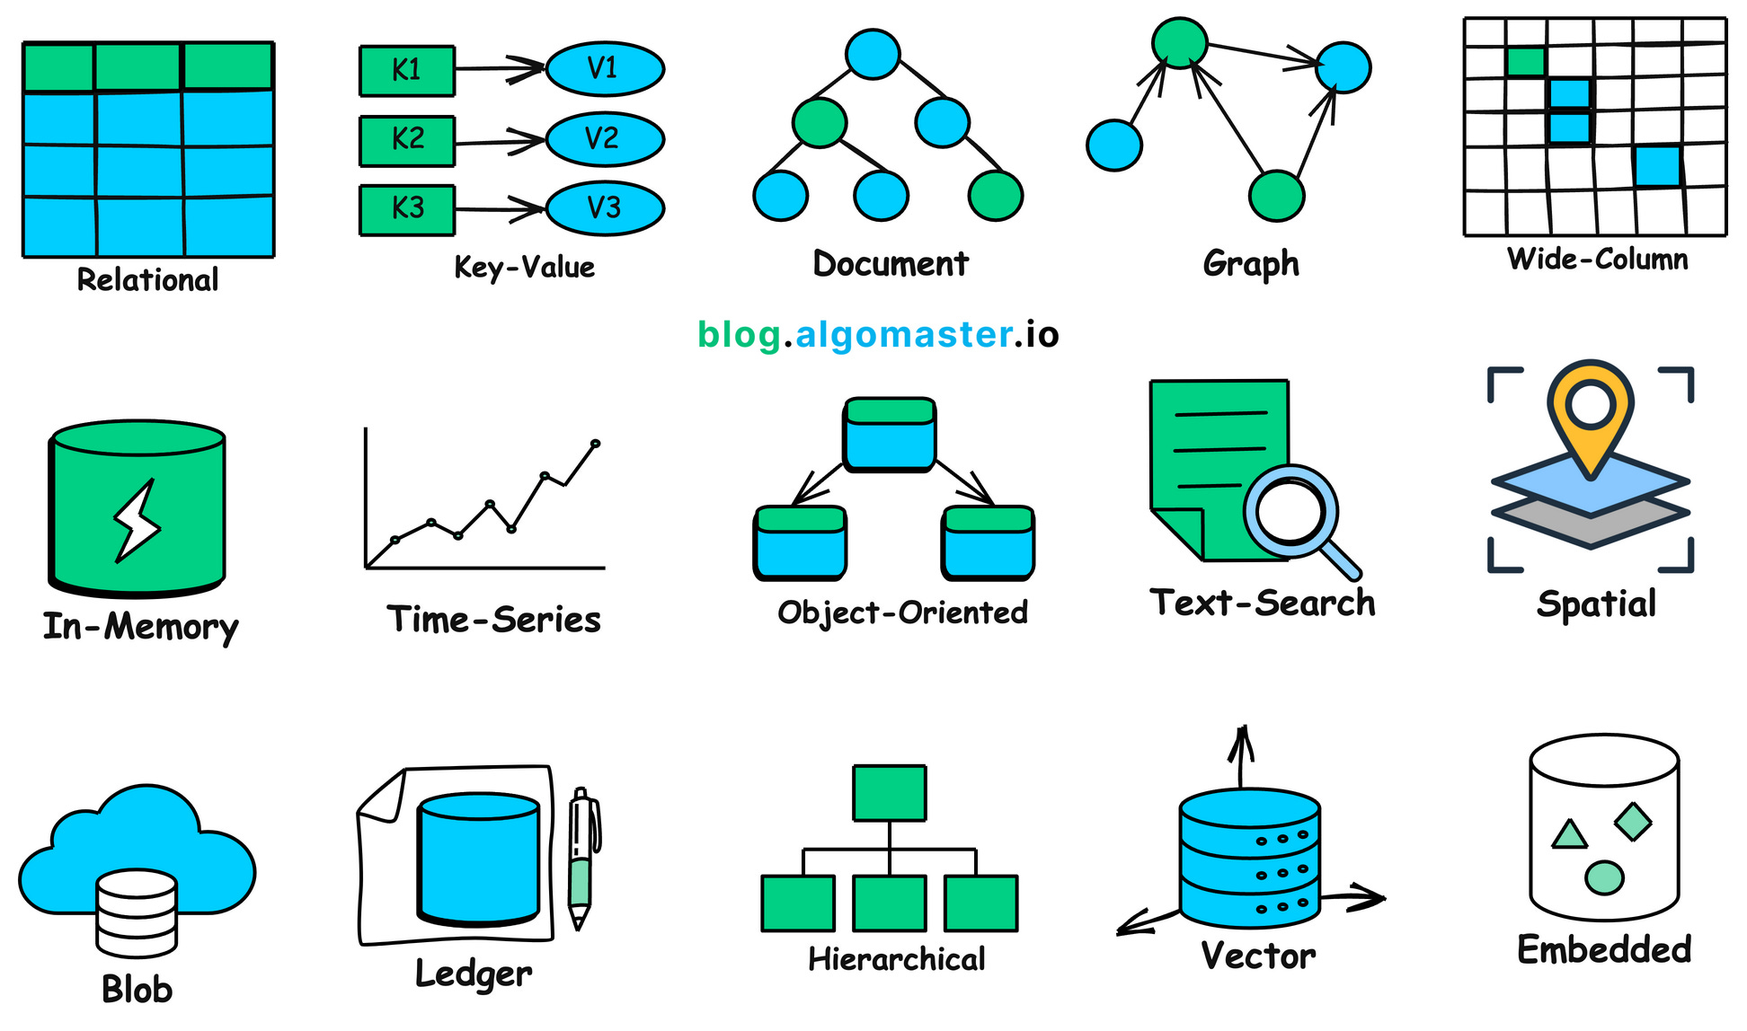

How Websites Work
2- Databases: A database is an organized collection of data stored electronically. It allows users and applications to easily access, update, and manipulate information. This data contains text, numbers, images, videos and more. Databases are managed using specialized software known as a Database Management System (DBMS)i.e MySQL, PostgreSQL, Microsoft SQL Server, and Oracle Database. which facilitates the storage, retrieval, and manipulation of data.
What is Database? - GeeksforGeeks
Course: Database Fundamentals* | Mahara-Tech

Slide 7
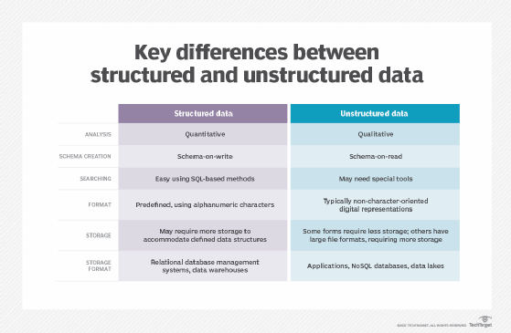
How Websites Work
Relational DBMS (RDBMS): Data is organized into tables with rows and columns, and relationships are established between tables. Examples include MySQL, PostgreSQL, Microsoft SQL Server, and Oracle Database.
NoSQL DBMS: These systems are designed for handling unstructured or semi-structured data and offer flexibility and scalability. Examples include MongoDB, Cassandra, and Redis.

Slide 8
How Websites Work
Relational DBMS (RDBMS): Data is organized into tables with rows and columns, and relationships are established between tables. Examples include MySQL, PostgreSQL, Microsoft SQL Server, and Oracle Database.
NoSQL DBMS: These systems are designed for handling unstructured or semi-structured data and offer flexibility and scalability. Examples include MongoDB, Cassandra, and Redis.

Slide 9
How websites work
3-backend roles:-
Authentication: The process of verifying a user's identity (e.g., login with email & password).
Authorization: The process of determining what a user is allowed to do (e.g., access admin panel).Database design & management
Database Design & Management: Organizing data into structured formats (tables or documents) and managing how it's stored, accessed, and updated in a database system.
API creation: Building interfaces (usually REST APIs) that allow different systems (like frontend & backend) to communicate using standard HTTP methods.
Security: Protecting the application and data from unauthorized access or attacks.
Scalability: The system’s ability to grow and handle increasing loads efficiently.
Performance: How fast and efficiently the system responds to users or requests.

Slide 10
How websites work
4- Frontend roles:-
Responsibilities:
Usability & Accessibility: Ensure the app is easy to use and accessible to all users, including those with disabilities.
User Interface (UI): Design and develop the layout, buttons, colors, and visual elements.
User Experience (UX): Focus on smooth, intuitive interactions and navigation.
API Integration: Fetch and display data from the backend.
Form Validation: Ensure input fields are correctly filled and prevent invalid submissions.
Platforms:
Web: Traditional websites accessed via browsers.
Mobile:
Native: Built specifically for iOS or Android (e.g., Swift, Kotlin).
Cross-platform: Shared codebase for multiple platforms (e.g., React Native, Flutter).

Slide 11
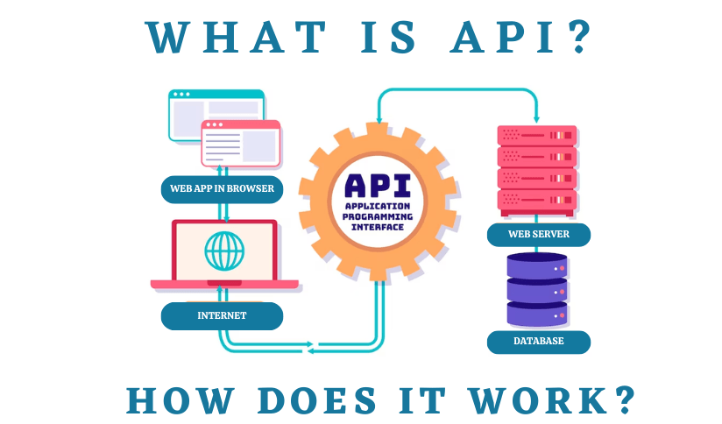
How websites work
4- What is an API & Intro to RESTful APIs
What is an API? API (Application Programming Interface) is a set of rules that allows different software applications to communicate with each other.
Why do we use it?
Connect frontend with backend
Access data or services from servers
Build scalable and reusable systems
What is an API? - Application Programming Interfaces Explained – AWS
JSONPlaceholder - Free Fake REST API

Slide 12
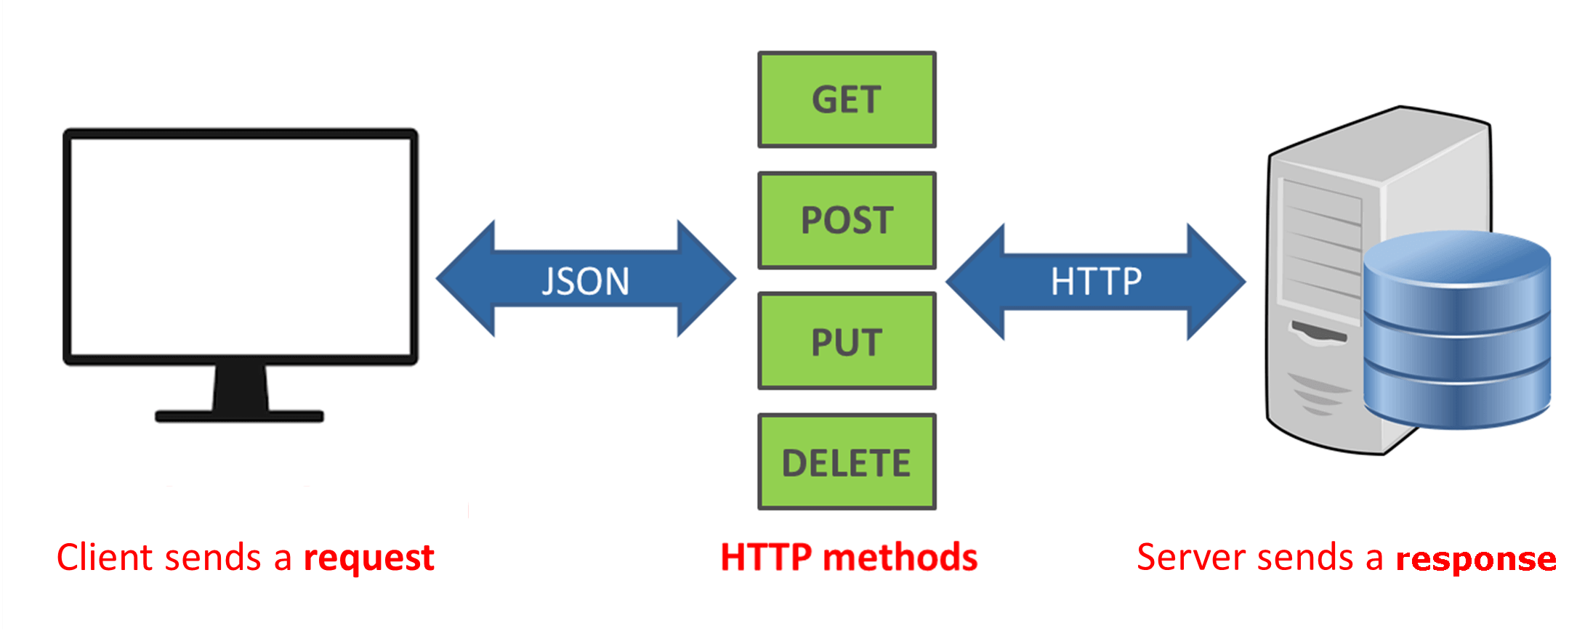
How websites work
4- What is an API & Intro to RESTful APIs
RESTful APIs - Introduction
REST (Representational State Transfer) is a common way to structure APIs using HTTP methods.
Basic HTTP Methods:
GET – Retrieve data
POST – Send new data
PUT – Update existing data
DELETE – Remove data
Example (JSON format):
GET /users → Get list of users
POST /users → Add a new user
GET /users/1 → Get user with ID 1
DELETE /users/1 → Delete user with ID 1

Slide 13
Course Overview
Core Foundations (Main Technologies)
Learn how to build responsive, interactive, and accessible web interfaces using:
HTML – Structure your web content using semantic markup.
CSS – Style and layout your content with modern techniques (Flexbox, Grid).
JavaScript – Add interactivity and dynamic behavior to your pages.
Bootstrap – Quickly create beautiful, responsive UIs using the most popular CSS framework.
Developer Tools & Enhancements (Secondary Technologies)
Git & GitHub – Version control your code, collaborate with others, and deploy your work.
Supabase – Add backend features (authentication, database, storage) using this open-source Firebase alternative.
TypeScript – Write safer, scalable JavaScript with static typing and modern development practices.

Slide 14




Course installation

Slide 15
Resources
Responsive Web Design | freeCodeCamp.org
JavaScript Algorithms and Data Structures | freeCodeCamp.org
https://maharatech.gov.eg/course/view.php?id=36
المقرر: لغة الجافا سكربت | Mahara-Tech
Bootstrap · The most popular HTML, CSS, and JS library in the world.
MDN Web Docs
https://youtube.com/playlist?list=PLxbVBWjVdAEjom8KOV1c9aXMCz4IE0OZy&si=JgDWxH0lsTbB6vRf
W3Schools Online Web Tutorials

Slide 16
HTML <p>hello world</p>
HTML (HyperText Markup Language)
In the late 1980s and early 1990s, Tim Berners-Lee, a software engineer at CERN, was trying to solve a big problem:
How can scientists around the world share and access documents easily, regardless of computer or operating system?
At that time, information was scattered, stored on different systems, and hard to link together.
HTML history: Milestones in the web markup language
A Brief History of HTML | WIRED
How HTML Was Created
1- Chose a Markup Language: Tim Berners-Lee needed a way to structure documents on the web, inspired by SGML, a complex markup system.
2- Simplified SGML: He created a simpler version of SGML, suitable for the internet — this became HTML.
3- Designed Basic Tags: Introduced readable
4- Built First Browser & Editor: In 1990, he developed WorldWideWeb (later Nexus)
5- Wrote the First HTML Page: Hosted at CERN, explaining what the World Wide Web is and how to use it.
Released the First Specification: In 1991, he published the first HTML draft — listing 18 original tags.

Slide 17
Getting Started
Open project folder in VS Code: Use cmd + code . (Mac) or code . (Windows/Linux).
HTML file extension: Save files with .html
Document Type Declaration:<!DOCTYPE html> — tells the browser to expect an HTML5 document.
html, head, title, and body are required tags.
Use <!-- Comment --> or Ctrl + / to comment.

Slide 18
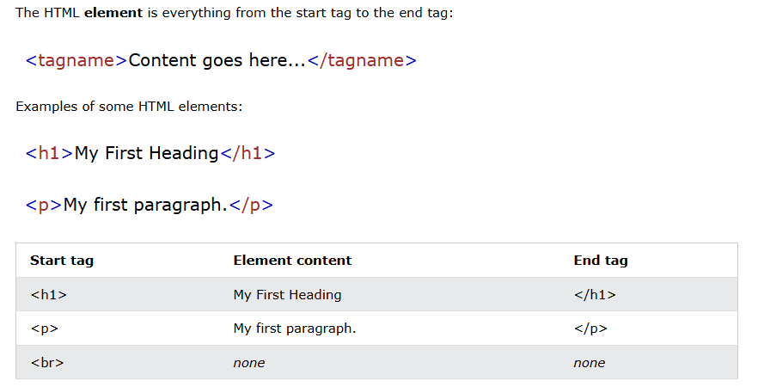
HTML Elements

Slide 19
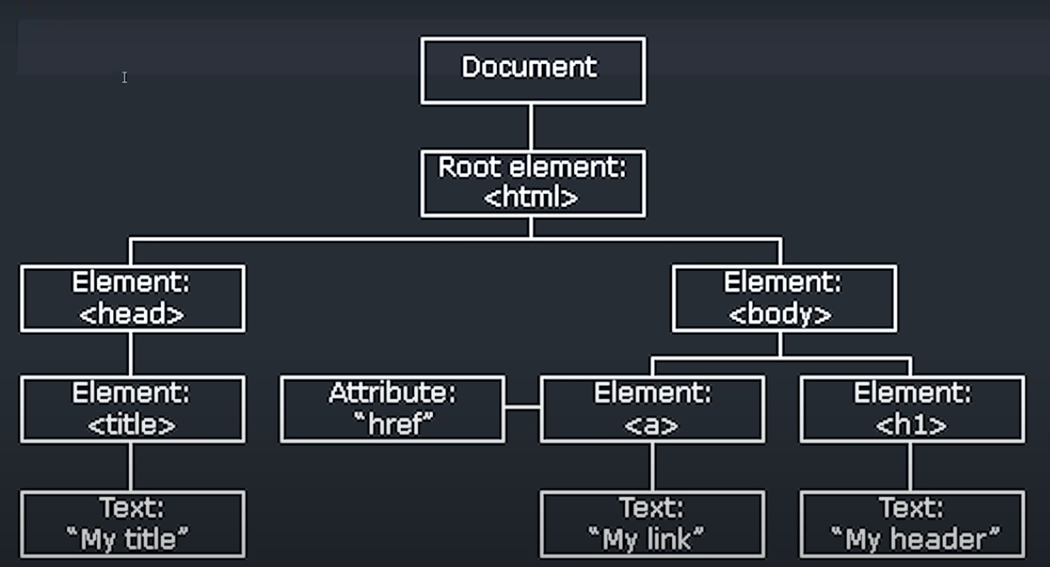
HTML Structure
<head> Tag – The Brain of the Page
The <head> contains metadata and non-visible information about the web page.
It helps the browser understand how to handle the page.
Contents inside <head> do not appear in the browser window (except indirectly).
<body> Tag – The Content of the Page
The <body> contains everything visible to the user.
All the text, images, buttons, forms, etc., go inside this tag.
What you see on the screen is rendered from the <body> section.

Slide 20
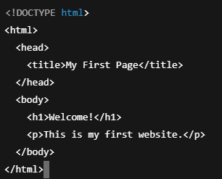
First Code

Slide 21
Text Elements & Headings
Headings: <h1> to <h6> — h1 should be used only once per page.
Dummy text: Use lorem10 in VS Code to auto-generate text.
HTML Elements
Block Elements:
Take full width.
Examples: <div>, <h1>, <p>, <section>, etc.
Inline Elements:
Appear on the same line with other elements.
Examples: <span>, <a>, <strong>, etc.

Slide 22
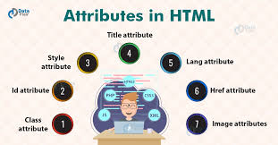
Attributes
What are HTML Attributes?
Attributes provide additional information about HTML elements. They are always written in the opening tag, and usually come as name="value" pairs.

Slide 23


Links & Images
Anchor Tags (<a>):
target="_blank" opens the link in a new tab.Use name.html instead of ./name.html for relative internal links.
Image Tags (<img>):
Alt & title is important for SEO and accessibility.
Use % for responsive width.

Slide 24
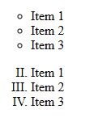
Lists
Unordered List:
<ul type="circle">
<li>Item 1</li>
<li>Item 2</li>
<li>Item 3</li>
</ul>
Ordered List:
<ol type="I" start="2">
<li>Item 1</li>
<li>Item 2</li>
<li>Item 3</li>
</ol>

Slide 25
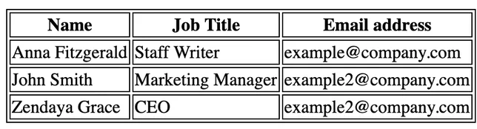
Tables
1- start with <table>
2- titles in <thead> or first row
3- main table in <tbody>
4- use <tr> to make row
5- <td> for normal data cells and <th> for heading cells
colspan — spans columns.
rowspan — spans rows.

Slide 26

Formatting & Layout
<hr> — Horizontal line (block element, empty tag).
<br> — Line break (not recommended when using CSS).
<pre> — Preserves formatting and spacing (great for code).
<strong>, <small> — Semantics and accessibility.
<del> — Deleted text.<sup> / <sub> — Superscript / Subscript text.

Slide 27
Some media tags
Ifram
An <iframe> (inline frame) is an HTML tag used to embed another webpage or content (like videos, maps, or documents) within the current page.
<iframe src="https://www.youtube.com/embed/videoID" name="myFrame"></iframe>
<a href="page.html" target="myFrame">Open in iframe</a>
video
<video controls width="500" height="300" poster="thumbnail.jpg">
<source src="movie.mp4" type="video/mp4">
<source src="movie.webm" type="video/webm">
Your browser does not support the video tag.
</video>
audio
<audio controls>
<source src="sound.mp3" type="audio/mpeg">
<source src="sound.ogg" type="audio/ogg">
Your browser does not support the audio element.
</audio>

Slide 28
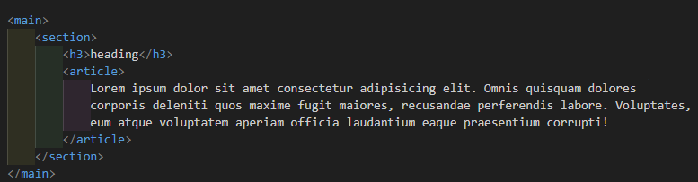
Semantic Tags
Use instead of <div> for meaningful structure:
<nav>, <header>, <main>, <section>, <article>, <aside>, <footer>

Slide 29
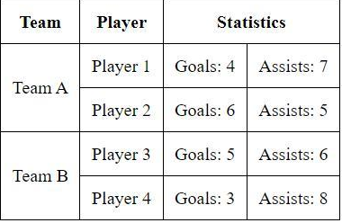
Task one
Simulation you make a website for the company use :-
1- paragraph to descript the company
2- use order and unorder lists to describe services and goals
3- some images with alt and title attributes
4- links social with when I click make the tap open in a new window
5- put a YouTube video
6- use Semantic elements
7- make some thing like this Table:
8- make footer and write copyright with entity code

Slide 30
Forms
<form> tag the container of inputs
Attributes:
action – the URL/page to send form data to
method – "get" (data in URL) or "post" (secure)

Slide 31
Forms
Common type values:
text, email, password, submit, reset, radio, checkbox, file, url, number, color, date, datetime-local, month, range
Input Validations:
required – makes field mandatory
maxlength / minlength – restrict character count
pattern – custom RegEx for advanced validation
disabled – user can’t edit, value won’t be sent
readonly – user can’t edit, value is sent

Slide 32
Forms
Other Attributes:
placeholder – dummy hint text inside input
value – default/pre-filled value
name – key used when submitting data (must be unique)autocomplete="off" – disables autofill
autofocus – auto-focuses on this input on page load
Submit & Buttons:
<input type="submit" value="Send">
<button type="submit">Submit</button>

Slide 33
Forms
File Upload
<input type="file" name="upload" multiple>
multiple allows multiple file selection
Radio Buttons
<input type="radio" name="gender" value="male"> Male
<input type="radio" name="gender" value="female"> Female
All radio buttons in a group must have the same name, different values

Slide 34
Forms
Checkboxes
<input type="checkbox" name="hobby" value="coding"> Coding
<input type="checkbox" name="hobby" value="music"> Music
Special Inputs
<input type="color" name="favColor">
<input type="date" name="birthDate">
<input type="datetime-local" name="appointment">
<input type="month" name="billingMonth">
<input type="range" min="0" max="100" step="10" name="volume">
<input type="number" name="age">
<input type="url" name="website">

Slide 35
Forms
Search & Suggestions (Data List)
<input list="browsers" name="browser">
<datalist id="browsers">
<option value="Chrome">
<option value="Firefox">
<option value="Safari">
</datalist>

Slide 36
Forms
Fieldset & Legend
Used to group related inputs in a form (improves accessibility & structure):
<fieldset>
<legend>Personal Info</legend>
<label for="name">Name:</label>
<input id="name" name="userName" type="text">
</fieldset>

Slide 37
Task two
1- search what is svg
2- what is map image and how to use it
3- complete this html only
Note : create account on freecodecamp
Learn HTML by Building a Cat Photo App: Step 1 | freeCodeCamp.org
Learn Accessibility by Building a Quiz: Step 1 | freeCodeCamp.org

Slide 38
Repo: ahmedsamir45/Frontend-Course: explain html css js bootstrap react

